Slide 1
Capstone Project - The Battle of Neighborhoods
To Open a Restaurant Business in Neighborhood
Of Sargodha, Pakistan

Slide 2
Introduction/Business Idea:
Target Audience
My target audience will mainly be any company that is interested in opening up a new facility in the region. I will provide them will valuable data predictions and comprehensive solutions

Slide 3
Data Preparation:
Scraping Sargodha Wards Table from Wikipedia:
We will divide the data into various clusters and then apply k means techniques to extract the best value of k
Using Foursquare Location Data
We have to use data from foursquare using the APIs by applying our knowledge of cleansing data through web and extracting location points.
Getting Coordinates of Major Districts
First of all we need to get the data of Sargodha city from Wikipedia and then start to implement the analysis or to be specific clustering techniques onto it for cleansing and extracting meaning

Slide 4
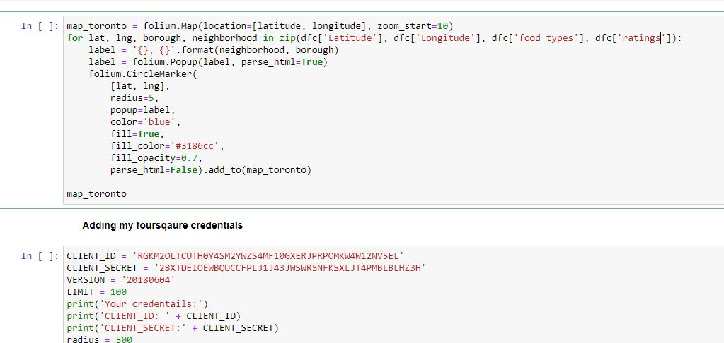
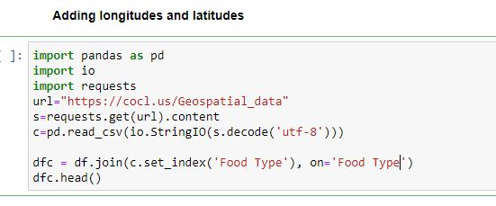

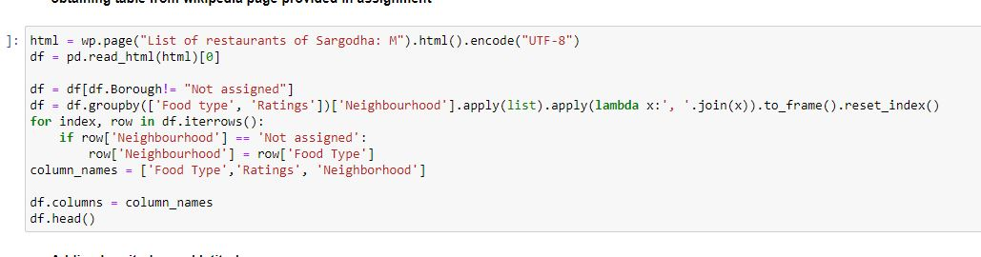
Code Snippets

Slide 5
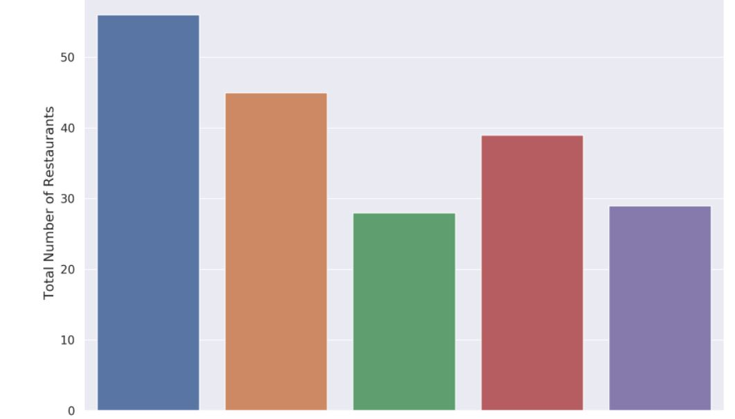
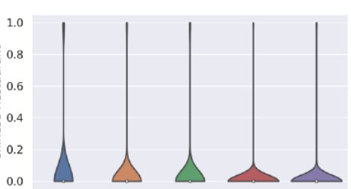
Visualization and Data Exploration
The visualized results will make us more clear about the situation of our data.

Slide 6
5. Results and Discussion:
We reach at the end of the analysis, using comprehensive data from Wikipedia and foursquare, it came out that the restaurants with traditional cuisines are mostly preferred in this region

Slide 7
6. Conclusion:
Finally to conclude this project, We have got a small insight of how real life data-science projects look like.
I’ve made use of some frequently used python libraries to scrap web-data, use Foursquare API to explore the major districts of Sargodha region and saw the results of segmentation of districts using Folium leaflet map.

